Slide 1
ASP.NET Architecture

Slide 2
Application Pool
One of the primary purposes behind application pooling is to support application isolation.
With application pooling, you also can govern the security aspects of a Web application.
Application pools operate under the Network Service account by default—which does not have as many access rights as Local System does.

Slide 3
ASP.NET Architecture
When an end user presses the Return key after typing in a URL, the browser sends an HTTP GET request to the target site.
The request travels through a series of routers until it finally hits your Web server and is picked up on port 80.
ASP.NET works with three versions of IIS:
version 5.x (if you are using the Windows XP Professional operating system),
version 6.x (if you are using the Windows Server 2003 operating system), and
version 7.x (if you are using the Windows Vista, Windows 7, or Windows Server 2008 operating systems).
When a request comes in, IIS reads the file name identified in the request and routes the request to the appropriate component.
Once IIS intercepts the request and maps it to the worker process, the request follows a very specific path through the pipeline.

Slide 4
The IIS 5.x and IIS 6.x Pipeline
Once a request comes into the AppDomain managed by the ASP.NET runtime, ASP.NET uses the HttpWorkerRequest class to store the request information.
The runtime wraps the request’s information in a class named HttpContext.
The runtime produces an instance of HttpApplication and then fires a number of application-wide events .
These events are also pumped through any HttpModules attached to the pipeline.
Finally, ASP.NET figures out what kind of handler is required to handle the request, creates one, and asks the handler to process the request.
After the handler deals with the request, ASP.NET fires a number of postprocessing events .

Slide 5
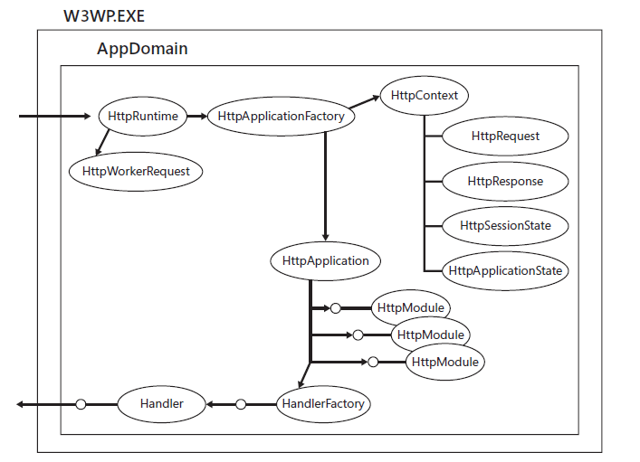
Pipeline

Slide 6
The HttpApplication
HTTP handlers live for a very short period of time.
Imagine in commercial grade project, one want to cache data to avoid round-trips to the database. You’d need to store that data in a place where all the HTTP handlers could get to it.
The HttpApplication class exists for that purpose—to act as a rendezvous point for your request processing.

Slide 7
The HttpContext
The HttpContext class acts as a central location in which you can access parts of the current request as it travels through the pipeline.
Even though the HttpContext components are really just references to other parts of the pipeline, having them available in a single place makes it much easier to manage the request.
A reference to the context’s Response object (so that you can send output to the client)
A reference to the Request object (so that you can find information about the request itself)
A reference to the central application itself (so that you can get to the application state)
A reference to a per-request dictionary (for storing items for the duration of a request)
A reference to the application-wide cache (to store data and avoid round-trips to the database)

Slide 8
The HttpModules
Although the Application object is suitable for handling application-wide events and data on a small scale, sometimes application-wide tasks need a little heavier machinery. HttpModules serve that purpose.

Slide 9
The HttpHandlers
The last stop a request makes in the pipeline is at an HttpHandler.
When a request finally reaches the end of the pipeline, ASP.NET consults the configuration file to see whether the particular file name extension is mapped to an HttpHandler.
If it is, ASP.NET loads the handler and calls the handler’s IHttpHandler.ProcessRequest method to execute the request.

Slide 10
ASP request’s path
The request lands in IIS.
IIS routes the request to aspnet_isapi.dll (binary component).
If IIS 5.x is running, IIS asp_isapi.dll routes the request through a pipe to aspnet_wp.exe.
If IIS 6.x is running, the request is already in the worker process.
ASP.NET packages the request context into an instance of Httpcontext.
ASP.NET pipes the request through an instance of an HttpApplication object (or an HttpApplication-derived object).
If the application object is interested in receiving any of the request preprocessing events, HttpApplication fires the events to the application object. Any HttpModules that have subscribed to these events will receive the notifications as well.
Runtime instantiates a handler and handles the request.

Slide 11
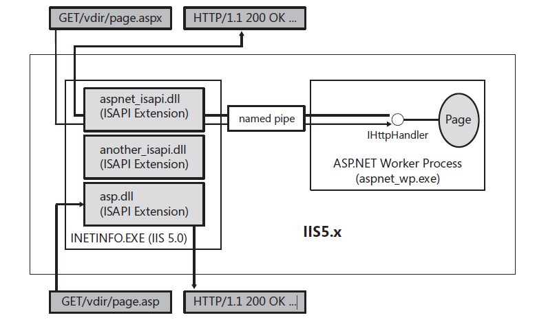
IIS 5.x working in concert with ASP.NET.

Slide 12
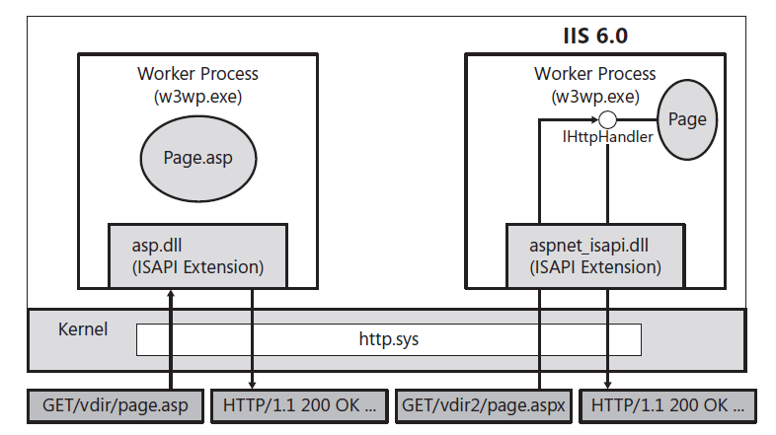
IIS 6.x working in concert with ASP.NET.

Slide 13
IIS 7 .x Request Path
The browser makes a request for a resource on the Web server.
HTTP.SYS picks up the request on the server.
HTTP.SYS uses the WAS to find configuration information to pass on to the WWW Service.
WAS passes the configuration information to the WWW Service, which configures HTTP.SYS.
WAS starts a worker process in the application pool for which the request was destined.
The worker process processes the request and returns the response to HTTP.SYS.
HTTP.SYS sends the response to the client.

Slide 14
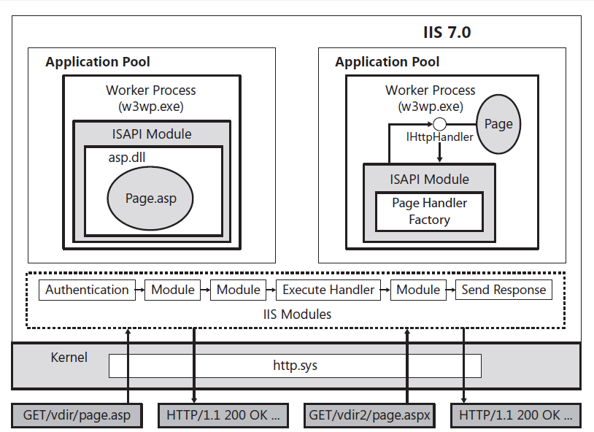
IIS 7.x working in concert with ASP.NET.

Slide 15
Thank You

